Slide 1
Olist E-COMMERCE STORE ANALYSIS
GROUP – 4
Palomee Boble | SHARON SCARIA | SARITHA PRASAD |
HARSHITA G |RENUKA KHANDAGALE | Prachi Raj

Slide 2
AGENDA
1) INTRODUCTION
2) DATA OVERVIEW
3) KEY POINT INDICATORS (OBSERVATIONS & SUGGETIONS)
4) DASHBOARD
5) CONCLUSION

Slide 3
INTRODUCTION
Olist, a Brazilian e-commerce platform, is optimizing performance through a comprehensive analysis project.
The focus includes customer behaviors, sales patterns, popular products, and seller performance to drive growth, improve efficiency, and inform decision-making.
Utilizing Excel, Tableau, Power BI, and MySQL, the project aims to enhance the e-commerce experience with impactful insights for marketing, inventory management, and seller onboarding.

Slide 4
DATA OVERVIEW
The Olist Data comprises details on 100k orders from 2016 to 2018, covering order status, pricing, payment, freight, customer location, product attributes, and reviews.
It includes components like customer information, geolocation, order items, payments, reviews, products, and sellers.
This dataset supports various analytical tasks, offering insights into customer behavior, product performance, and operational efficiency in the Olist e-commerce ecosystem.

Slide 5
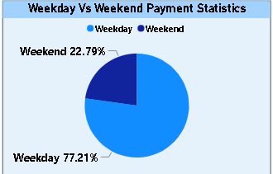
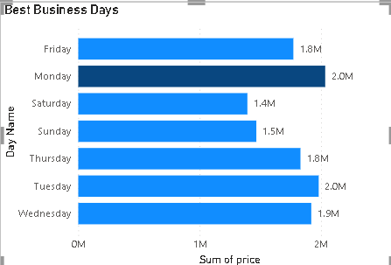
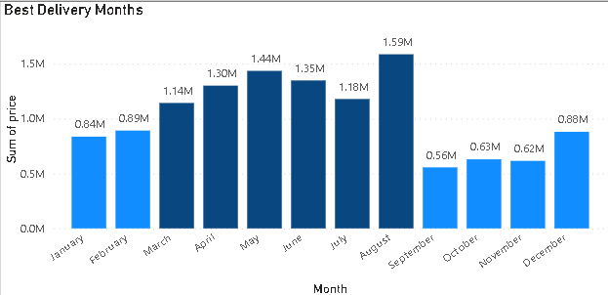
KPI 1– WEEKDAY VS WEEKEND PAYMENT STATISTICS
OBSERVATIONS:
Maximum payments are received on weekdays.
Weekends contributed only 23% to total payments.
SUGGESTIONS:
Weekend Exclusive Offers
Bundle Deals and Packages

Slide 6
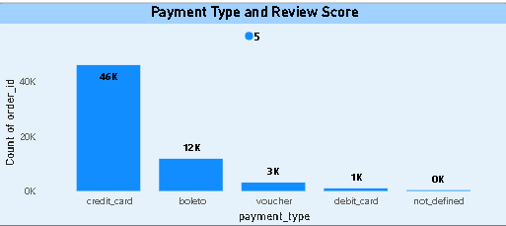
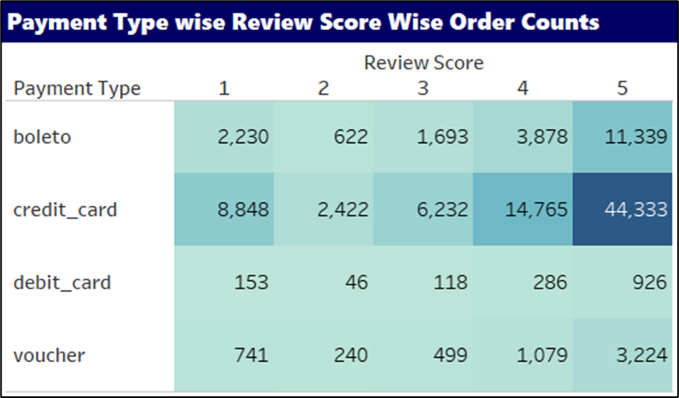
KPI 2–NUMBER OF ORDERS VS REVIEW SCORE USING CREDIT CARD
OBSERVATIONS:
Maximum payments are made through credit cards
Maximum credit card payments have received 5 review score among all other modes of payment(44k).
SUGGESTIONS:
Proactive Communication
Feedback Solutions
Enhanced Customer Support

Slide 7
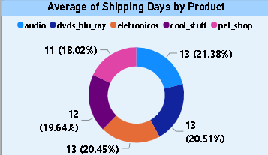
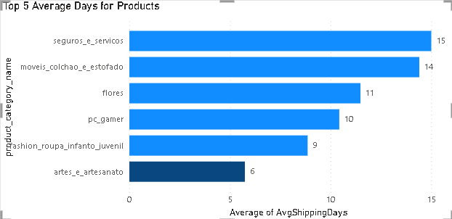
KPI 3–AVERAGE NUMBER OF DELIVERY DAYS FOR PET SHOP
OBSERVATIONS:
11 days is the average days taken to deliver the order for pet shop.
Significant improvement in delivery speed over the years
SUGGESTIONS:
Continued Process Enhancement
Proactive Customer Communication

Slide 8
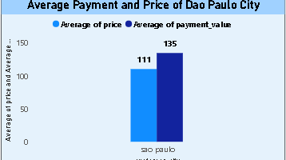
KPI 4–AVERAGE PRICE & PAYMENT VALUES FOR SAO PAULO
OBSERVATIONS:
Sao Paulo City – Average price is 111 and average payment is 135
SUGGESTIONS:
Optimize Delivery Speed
Clear Communication
Cost-Efficiency Strategies

Slide 9
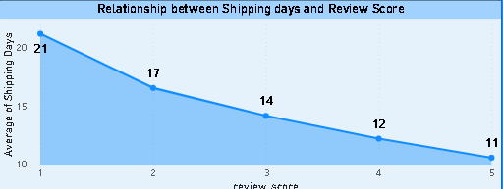
KPI 5–RELATIONSHIP BETWEEN SHIPPING DAYS VS REVIEW SCORE
OBSERVATIONS:
More the number of days taken to deliver the product, the lower is the review score.
11 average shipping days taken for review score 5 & 20 average shipping days taken for review score 1.
SUGGESTIONS:
Prioritize Swift Deliveries
Efficient Logistics Implementation

Slide 10
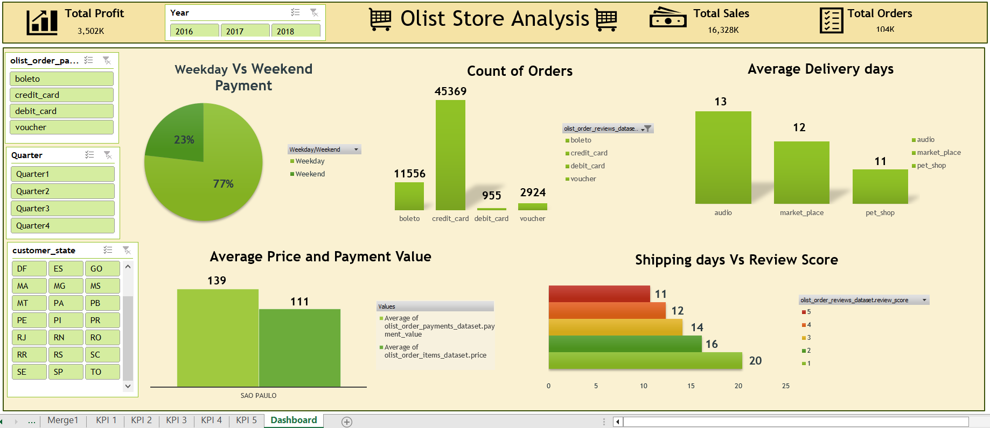
EXCEL DASHBOARD

Slide 11
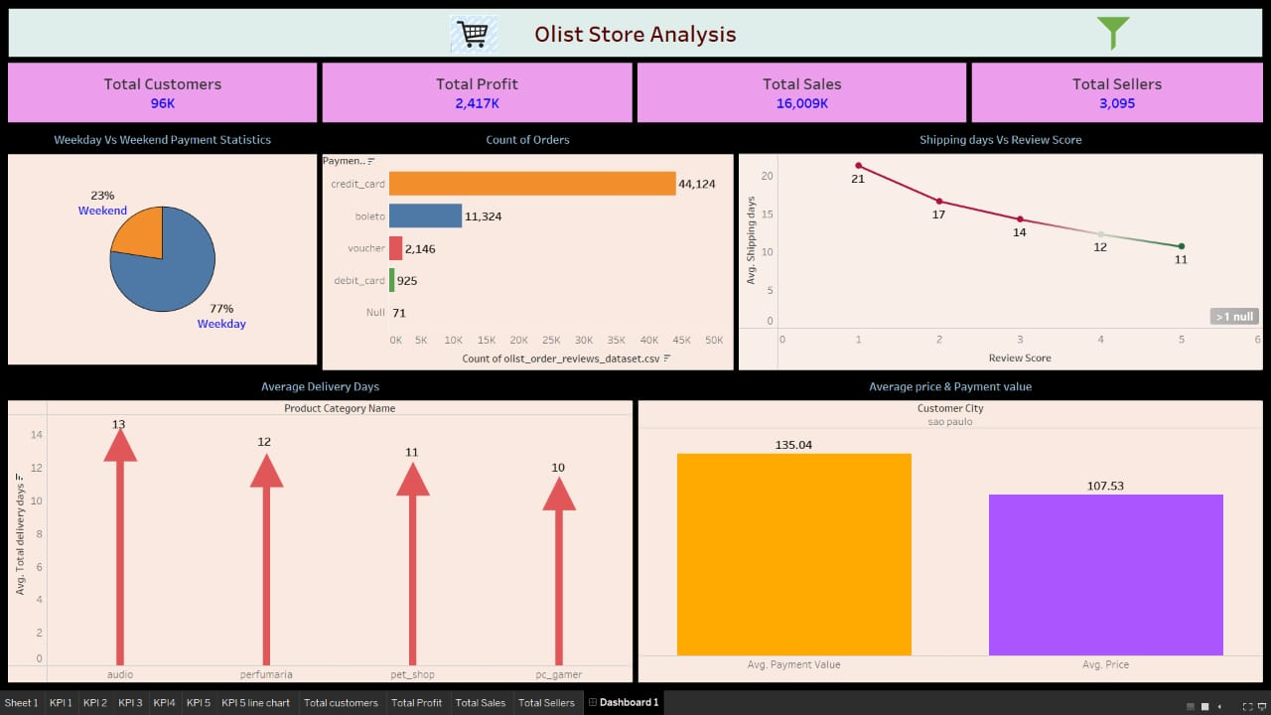
TABLEAU DASHBOARD

Slide 12
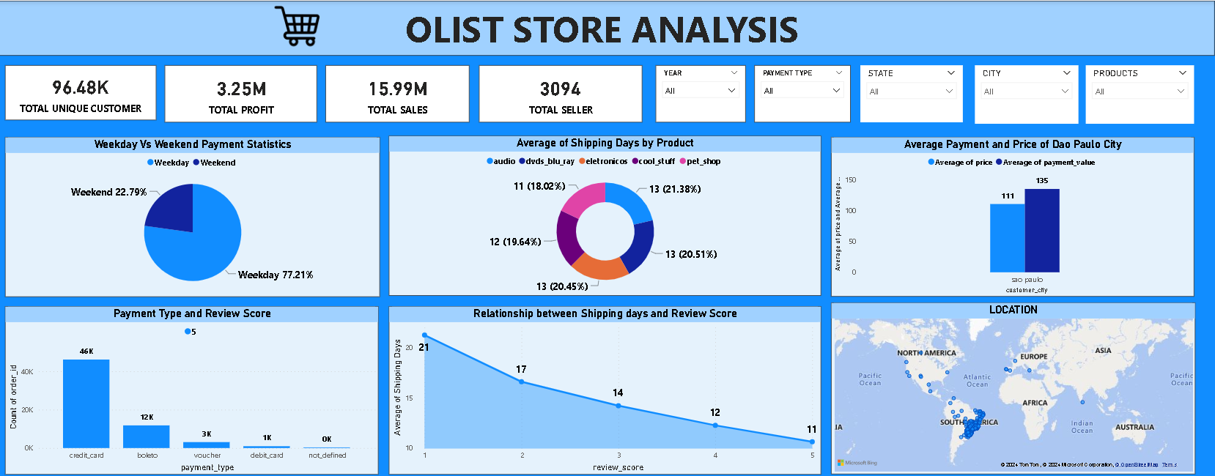
POWER BI DASHBOARD

Slide 13
CONCLUSION
The analysis emphasizes product categories, linking pricing and customer review scores.
By adjusting pricing strategies and enhancing products based on consumer feedback, the company can boost revenue and expand the product range in each category.
It's crucial for the organization to actively address customer reviews, continually adapt, and refine the product offerings.
Future efforts could explore applying these insights to enhance revenue in similar e-commerce setups in Brazil.

Slide 14
THANKYOU

